Slide 1
Performance Analysis & Insights
IT Support Dashboard
K.Jashvanth

Slide 2
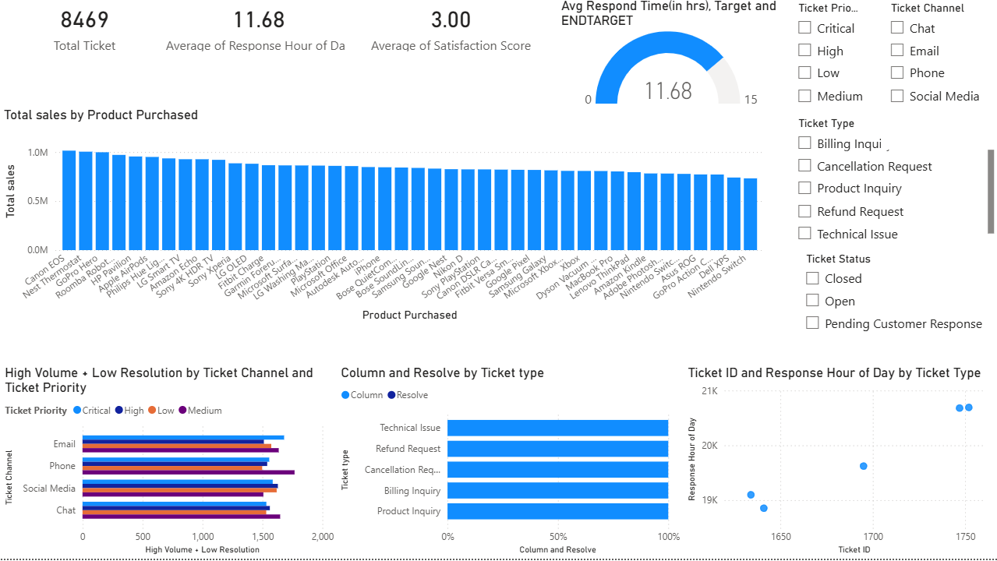
Dashboard Overview
Overview of IT Support Metrics

Slide 3
Key Metrics
Total Tickets Handled: 8,469
Indicates overall workload and customer engagement volume.
Average Response Time: 11.68 Hours
Reflects the time taken to respond to customer queries. Opportunity to improve responsiveness.
Customer Satisfaction Score: 3.00 / 5
Shows moderate satisfaction level, highlighting scope for service quality enhancement.

Slide 4
SLA Performance
Response Time compared with SLA Target
Current response time is slightly above the defined SLA limits.
Slight Delay Observed
Minor delays in responding to tickets are impacting overall performance metrics.
Opportunity for Improvement
Streamline ticket handling processes
Improve team responsiveness
Leverage automation for quicker initial responses

Slide 5
Tickets by System
Identifies Systems Generating the Most Tickets
Highlights key applications or systems with higher issue frequency.
Helps Prioritize IT Resources
Enables focused allocation of support teams to high-impact areas.

Slide 6
Channel Performance
Email & Phone Show High Volume
Majority of tickets are generated through these support channels.
Lower Resolution Efficiency
Compared to other channels, resolution time and effectiveness are lower.
Needs Optimization
Improve handling processes for email and phone support
Introduce standardized response templates
Enhance agent training for faster resolution

Slide 7
Ticket Type Insights
Technical Issues Dominate
Majority of tickets are related to system errors, bugs, or functionality issues.
Refund & Billing Also Significant
Financial-related queries form a notable portion of support requests.

Slide 8
Response Time Analysis
Consistent but Slightly High
Performance metrics remain stable but are above the optimal range.
Workflow Optimization Needed
Streamline processes to reduce delays
Eliminate bottlenecks in ticket handling
Improve coordination between teams

Slide 9
Key Insights
High ticket volume
• SLA gaps
• Channel inefficiencies
• Moderate satisfaction

Slide 10
Recommendations
High ticket volume
SLA gaps
Channel inefficiencies
Moderate satisfaction

